Slide 1




INFO5990 Professional Practice in IT Lecture 11B
Intellectual property
Copyright and patents

Slide 2
By the end of this lecture you will be able to:
Understand what is meant by “intellectual property”
Appreciate the range of mechanisms for the protection of intellectual property
Explain basic issues relating to copyright and patents

Slide 3
What is Intellectual Property (IP) ?
Represents the property of your mind or intellect.
It can be worth money and may be sold on to other parties to utilise
It may give you the ‘edge’ which will make your company successful
It may be stolen and/or used without permission

Slide 4
Examples of Intellectual Property
books
original articles
music
artwork
research
inventions
designs
trade marks
proprietary knowledge or trade secrets
circuit layouts
plant or animal breeder’s ‘creations’
software

Slide 5
Question 1
Which of the following statements regarding intellectual property is TRUE
Represents the property of your mind or intellect.
It can be worth money and may be sold on to other parties to utilise
It may give you the ‘edge’ which will make your company successful
It may be stolen and used without permission
ALL of the above

Slide 6

Protecting other Intellectual Property
Registration of IP is administered in Australia by IPAustralia www.ipaustralia.gov.au
Patents
Designs
Trade marks
Business names

Slide 7
Patents
Legally enforceable
Owner has exclusive right to commercially exploit the invention for the life of the patent
Can only apply to technology , i.e. something that is a product, a composition or a process.
Must be novel, i.e. different from anything that has gone before.
Must be useful, i.e. have the potential for commercial return
Must be inventive, i.e. the result of some ingenuity on your part, not just a solution to a problem that would have been obvious to anyone.

Slide 8
Inventive (“non-obvious”)
To decide whether it is “non-obvious” you must consider first:
the scope and content of the prior art
the level of ordinary skill in the art
the differences between the claimed invention and the “prior art”.
In addition you must also consider:
commercial success
long-felt but unsolved needs
failure of others.

Slide 9
The patenting process
Involves full disclosure - a full description of how the invention works
The patent office then examines the application to ensure it fulfils the three criteria and does a patent search
Members of the public can object if they hold patent for something similar
Process can take more than a year
Patent lasts for 20 years

Slide 10
Disclosure
A detailed description of at least one way of carrying out the invention, addressed to a person skilled in the art
Must disclose any feature essential for carrying out the invention and in sufficient detail to render it apparent how to put the invention into practice.
A single example may suffice, but may need several to cover all possibilities

Slide 11
Disclosure: beware!
The invention should not be made public until it has legal protection.
If you demonstrate, sell or discuss your invention in public or publish about it before you file, you cannot get a patent.

Slide 12
The Cost
The cost of an Australian standard patent including attorney fees is usually between $5000-$25000.
Annual maintenance fees are payable from its fifth year. Over a 20-year term these will add a further to the cost.

Slide 13
Innovation patent (called ‘petty patent’ prior to 2001)
'no frills' patent, but still requires examination and search by the patents office to be effective
takes between one and three months.
lasts for only 8 years.
suited to inventions with a short commercial life or that are under development

Slide 14
What cannot be patented
ideas, concepts or facts
discoveries, scientific theories and mathematical methods;
schemes, rules and methods for performing mental acts, playing games or doing business,
programs for computers
presentations of information
aesthetic creations, literary, artistic, dramatic or musical works - these are protected by copyright;
something that occurs naturally, natural events

Slide 15
Question 2
For a patent to be granted the invention must
Relate to technology of some sort
Must be novel, that is different from anything before
Must be “non-obvious”, that is include an inventive step
Must have the potential for commercial gain
Must satisfy ALL of the above

Slide 16
Some classic cases

Slide 17
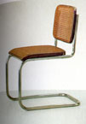
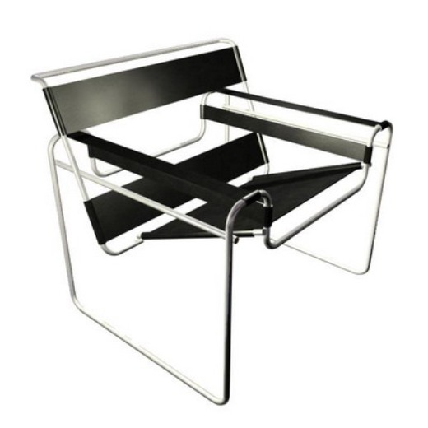
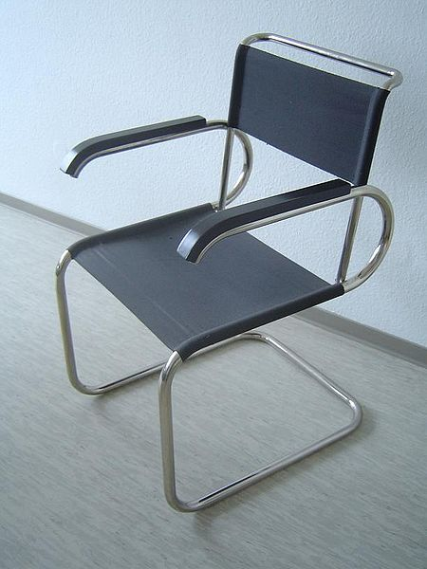
The Cantilever chair
A contribution of Bauhaus school of modern furniture design 1926 - 1928
Dutch architect/designer Mart Stam and German lecturer at Bauhaus school Marcel Breuer had each worked independently on the cantilever concept
Breuer lost a legal battle for the patent to Mart Stam who was granted the patent rights
Marcel Breuer
Mart Stam
Marcel Breuer

Slide 18
Some Famous Australian Patents
Refrigeration, 1868
‘Sunshine’ Stripper Harvester 1885
Hills Hoist 1945
‘Victa’ Lawn Mower 1952
Wine cask 1973
Dynamic Lifter 1970
Cochlear Bionic Ear Implant 1978*
*10 Oct, 2012
Medical firm Cochlear have won $100 million contract to supply 2,283 implants to Chinese Government over next 5 years
http://www.ipaustralia.gov.au/patents/ex_index.shtml

Slide 19
What if you don’t patent?
Frank Bannigan, of Kambrook appliances found out the hard way.
The electrical power-board, invented in 1972, was not patented and many other manufacturers made similar devices.
Bannigan says, 'I've probably lost millions of dollars in royalties alone. Whenever I go into a department store and see the wide range of power-boards on offer, it always comes back to haunt me.'

Slide 20
Success rate of patent litigation
In Australia between 1997 and 2003:
Only 15 claims out of 29 (55%) upheld
Similarly in the US courts the success rate was between 54 and 67 per cent
The most common grounds for invalidity of claim were
lack of novelty,
obviousness, or
no fair basis for comparison

Slide 21
Patent litigation (Australia, 1997-2003 )
Classification | Number
Electrical devices | 1
Information technology | 1
Analysis, measurement, control | 1
Pharmaceuticals, cosmetics | 3
Biotechnology | 1
Basic chemical processing, petrol | 5
Mechanical elements | 8
Handling, printing | 3
Agriculture/food machinery | 3
Space technology, weapons | 1
Consumer goods & equipment | 1
Civil engineering, building, mining | 5
Total | 33

Slide 22
Question 3
If you hold a patent for a new machine for spreading fertilizer on lawn tennis courts and someone challenges you in court
You are likely to win the case if it is a novel idea
You have about a 50% chance of winning
You have to go on and register the patent again
The person has to show that their idea is better
The judge will decide who has rights to the patent

Slide 23
Patenting Software
A claim containing a mathematical formula may be patentable
“if it implements or applies the formula in a structure or process which, when considered as a whole, is performing a function which the patent laws were designed to protect”
You can patent computer software, if it can be shown to have practical use that results in commercial returns
in practice most software developers prefer to rely on copyright to protect their programs

Slide 24
First software patent
On 21 May 1962, a British patent application entitled "A Computer Arranged for the Automatic Solution of Linear Programming Problems" was filed.
The invention was concerned with efficient memory management for the simplex algorithm, and could be implemented by purely software means.
The patent was granted on August 17, 1966 and seems to be one of the first software patents.

Slide 25
When is software patentable?
If it provides a new and non-obvious technical solution to a technical problem:
a way of making a computer run faster or more efficiently in a novel and inventive way.
a way of making the computer easier to use
Since 1978, some 30,000 patents for computer-implemented inventions have already been issued by the European Patent Office

Slide 26
VisiCalc 1979 Dan Bricklin and Bob Frankston
“In 1979 patents for software inventions were infrequently granted so we chose not to risk $10,000.”
computer programs were deemed mere mathematical algorithms
mathematical algorithms, as ‘laws of nature’, were not patentable
10% chance of success, even proposing it as ‘a machine’ (not software)
1981 US Supreme Court decision but too late to patent the spreadsheet

Slide 27
The Smart card (2001)
1998 State Street Bank ruling that "business methods are potentially patent-eligible".
‘Street test’ states that ‘anything which produces a useful, concrete and tangible result is patentable’.
A credit smart card containing a computer chip to record various loyalty and reward points offered by different traders was therefore patentable as a business method …
… because the scheme included a means for putting the scheme into effect.

Slide 28
The Bilski case (2010)
In 1997, Bernard Bilski had filed a patent application in relation to hedging risks in commodity trading.
The United States Patent & Trademark Office rejected the application.
Bilski appealed in November 2009.
28 June 2010, the US Supreme Court handed down decision: …
“not patentable if it falls into either categories of (i) laws of nature (ii) physical phenomena or (iii) abstract ideas”.

Slide 29
And so it goes …
Computer-implemented inventions which only solve a business problem using a computer, rather than a technical problem, are considered unpatentable as lacking an ‘inventive step’.
In Australia, pure or abstract methods of doing business are not considered to be patentable, but if the method is implemented using a computer, it can avoid the exclusion applying to business methods.

Slide 30
Some Software Patents (1)
Patent #4,965,765: covers “the use of different colors to distinguish the nesting level of nested expressions” . It is held by IBM.
Patent #5,249,290: covers assignment of client requests to the server process having the least load.
Patent #4,941,125: covers using a digital camera in conjunction with character recognition software to store and index documents on a CD ROM.

Slide 31

Some Software Patents (2)
Patent # 7,415,666, granted August 19, 2008. Title: “Method and system for navigating paginated content in page-based increments” (= “Page Up, Page Down” navigation keys)
Patent # 6,727,830, granted April 27, 2004 to Microsoft. Title: “Time based hardware button for application launch” (=“Double click”)
Euro Patent #394160: covers the progress bar

Slide 32

Copyright

Slide 33
Copyright: The Berne Convention
Signed in Berne, Switzerland, in 1886.
In 1997 delegates from160 countries discussed digital media, films, music, software, and television and distribution via the Internet
Automatic copyright protection is the central feature of the Berne accord.
121 countries including USA are signatories

Slide 34
Articles of the Berne Convention
Article 1: Protected Works
“Literary and artistic works”;
Derivative works;
Official texts;
Collections;
Works of applied art and industrial designs;
News

Slide 35
Question 4
Which of the following statements regarding copyright is TRUE
Copyright in Australia is automatic and free
The Berne convention excludes Australia from its conditions
Copyright does not apply to articles published in a learned journal
If you only base your work loosely on other work you can avoid infringing copyright
ALL of the above

Slide 36
10 Copyright myths Art Majlessi, 2004, http://www.legalmetro.com/library/copyright-law-explained.html
"If it doesn't have a copyright notice, it's not copyrighted."
False. According to the Berne copyright convention, anything created privately after April 1, 1989 is copyright.
It does not need the © symbol or anything else.
"If I don't charge for it, it's not a violation."
False, but it may matter if the court decides to award monetary damages.
"If it's posted to the internet it's in the public domain."
False. Copyright law still applies and the copyright still belongs to the author.

Slide 37
10 Copyright myths (2)
"My posting was just fair use!"
False. “Fair use,” applies only to parody, commentary, news reporting, and some educational purposes.
"If you don't defend your copyright you lose it."
False. This regulation applies to business names only.
"If I make up my own stories, but base them on another work, my new work belongs to me."
False. There is a specific section in copyright law that refers to “derivative works.”
If you use the same settings and characters in a new story, those characters still belong to the original author, so you need to seek permission.
Parodies are the only exception in this case.

Slide 38
10 Copyright myths (3)
"They can't get me; defendants in court have powerful rights!"
Copyright violations don't end up in court unless the copyright holder sues the offender.
But, it is easier to get a judgment in a civil court because the “beyond proof of a reasonable doubt” requirement doesn’t apply to civil suits.
"Copyright violation is not crime"
The copyright owner can sue.
In the US, copyright infringements valued at over $25,000 are classed as a felony, so you can go to jail for it.

Slide 39
10 Copyright myths (4)
"It doesn't hurt anybody -- in fact it's free advertising."
False. The author has to want that publicity to make it legitimate.
Permission must always be obtained.
“Someone e-mailed me a copy, so it is all right for me to use it as I will."
The copyright is still protected and belongs to the author.

Slide 40
Q5. Under which of the following circumstances is it all right to copy copyright material?
If it doesn't have a copyright notice
If you don't charge for it
If it's posted to the internet by someone else
If you make “just fair use” of it on the internet
NONE of the above

Slide 41
Further examples of IP protection (1)
Registered Business Name: A search of Business Names database costs $40
Registered Design: a product’s unique overall appearance, shape, configuration, pattern and ornamentation can be protected, regardless of function
Registered Trade Mark: a word, phrase, letter, number, sound, smell, shape, logo, picture, aspect of packaging or a combination of these

Slide 42
Further examples of IP protection (2)
1989 Circuit Layouts Act
covering the three-dimensional configuration of electronic circuits in integrated circuit products or layout designs
1987 Plant Variety Rights Act and 1994 Plant Breeder’s Rights Act
provide exclusive commercial rights to market a new variety of plant or its reproductive material
Examples: new plant varieties, plant components such as genes or chromosomes, reproductive material, chemicals or pharmaceuticals from plants

Slide 43
Question 6
Write down your score
Which of the following is FALSE
It is possible to register a design without regard to function
Software can be patented in the same way that technology can
Any kind of trade mark or sign can be registered
A normal patent once granted is valid for 20 years
An innovation patent is valid for only 8 years

Slide 44

Next Week
Last official lecture
Week 13 is revision & Student Feedback completion !!

